Slide 1
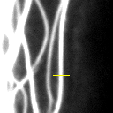
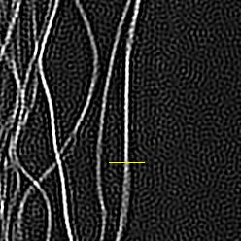
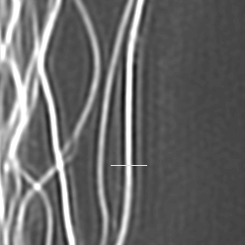
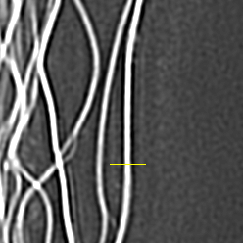
Cropped, contrast-enhanced image
Radially-averaged Fourier image plot
Line profile
Widefield
w: 0.01 a: 0.1
w: 1.0 a: 0.1
w: 0.2 a: 1.0

